Slide 2
Where do we go from here?
Dark Energy
The unknown energy that is causing the acceleration of the expansion of the universe.
Supernovae in distant galaxies are further (so dimmer) than they should be, thanks to an accelerating universe.
They are traveling faster than predicted by their redshift spectrum according to Hubble’s Law.
Through the study of light from these distant supernovae, it was determined that the slowing universe started to speed up again 5 billion years ago.

Slide 3
Where do we go from here?
Dark Matter
90% of matter in and between galaxies is of an unknown form that does not emit or absorb light (so we can’t see it).
It can be detected through its gravity by the way it affects objects we can see.
Without dark matter, normal matter would have been unable to clump and form stars and galaxies - and us.

Slide 5
“Normal Matter”
4%
Dark Energy
73%
Dark Matter
23%

Slide 6
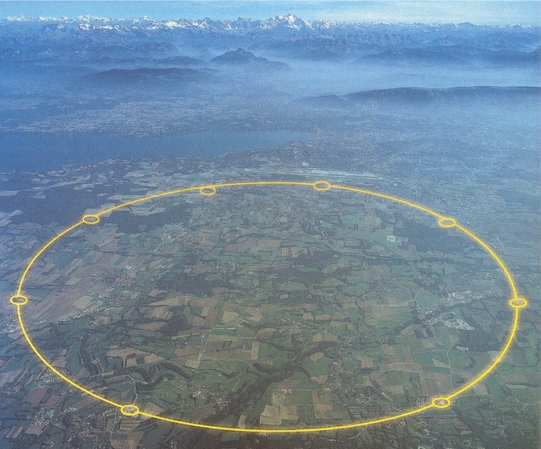
CERN HADRON COLLIDER
http://www.youtube.com/user/CERNTV?blend=9&ob=5#p/c/C193B03B29D263DE/0/UDoIzvKumGI

Slide 7
The Large Hadron Collider (LHC) is a gigantic scientific instrument near Geneva, where it spans the border between Switzerland and France about 100 m underground
It is a particle accelerator used by physicists to study the smallest known particles – the fundamental building blocks of all things
It will revolutionise our understanding, from the minuscule world deep within atoms to the vastness of the Universe.

Slide 8
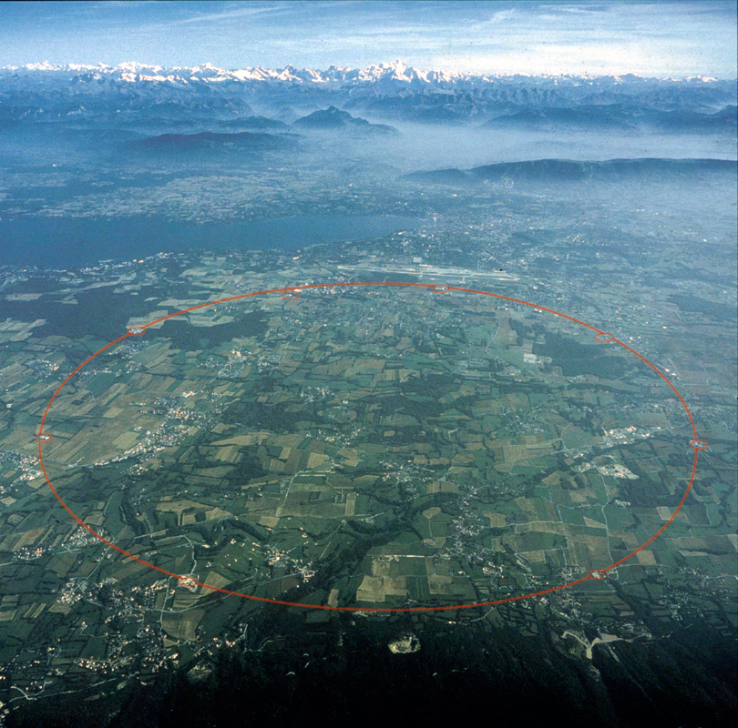
Notes:
Location of the Large Hadron Collider underground near Geneva, Switzerland
(CERN)

Slide 9
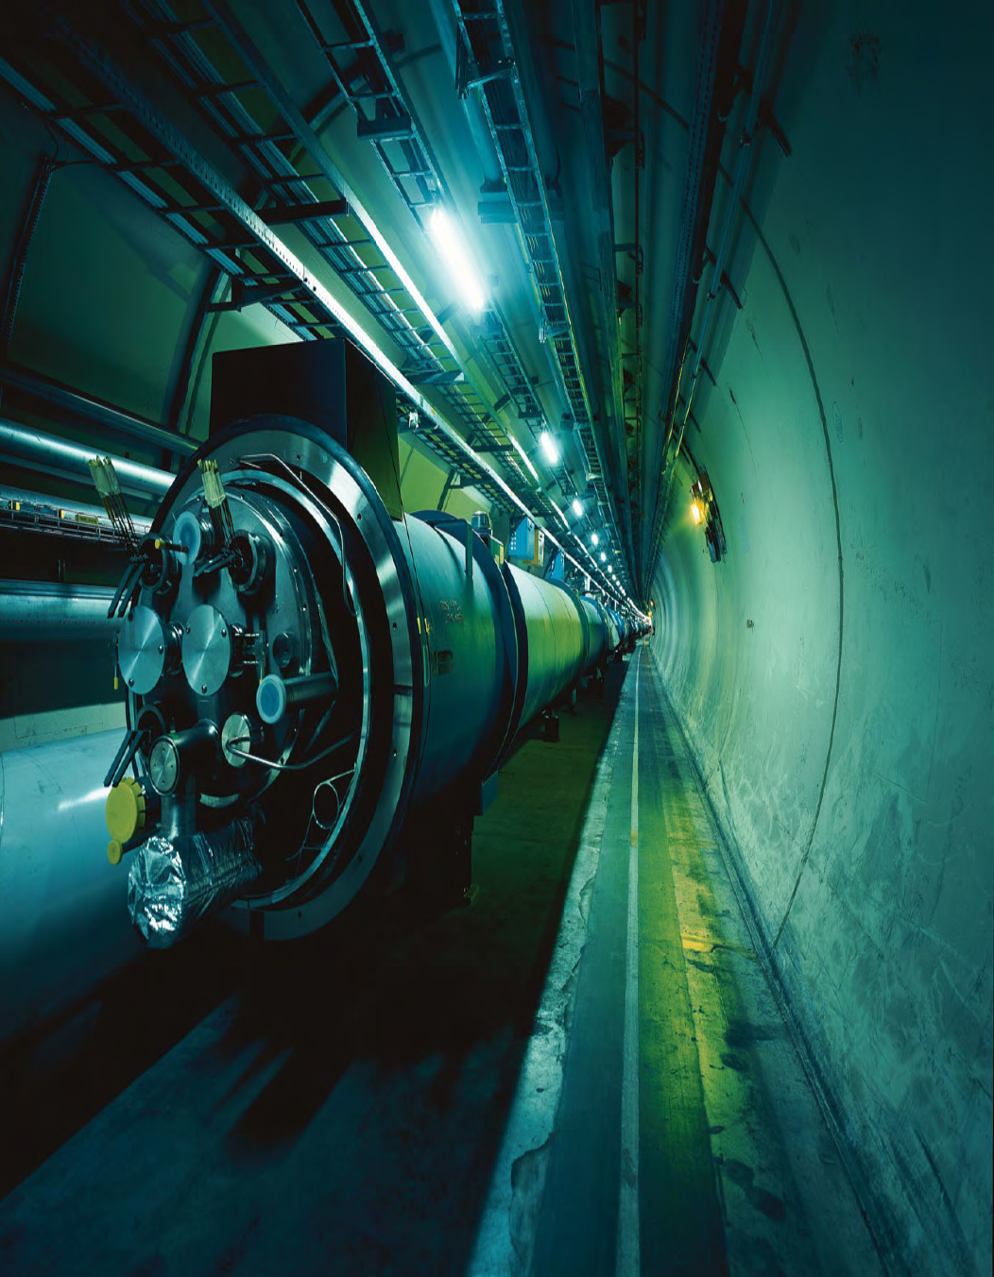
SEED
Notes:
Large Hadron Collider
(CERN)

Slide 10
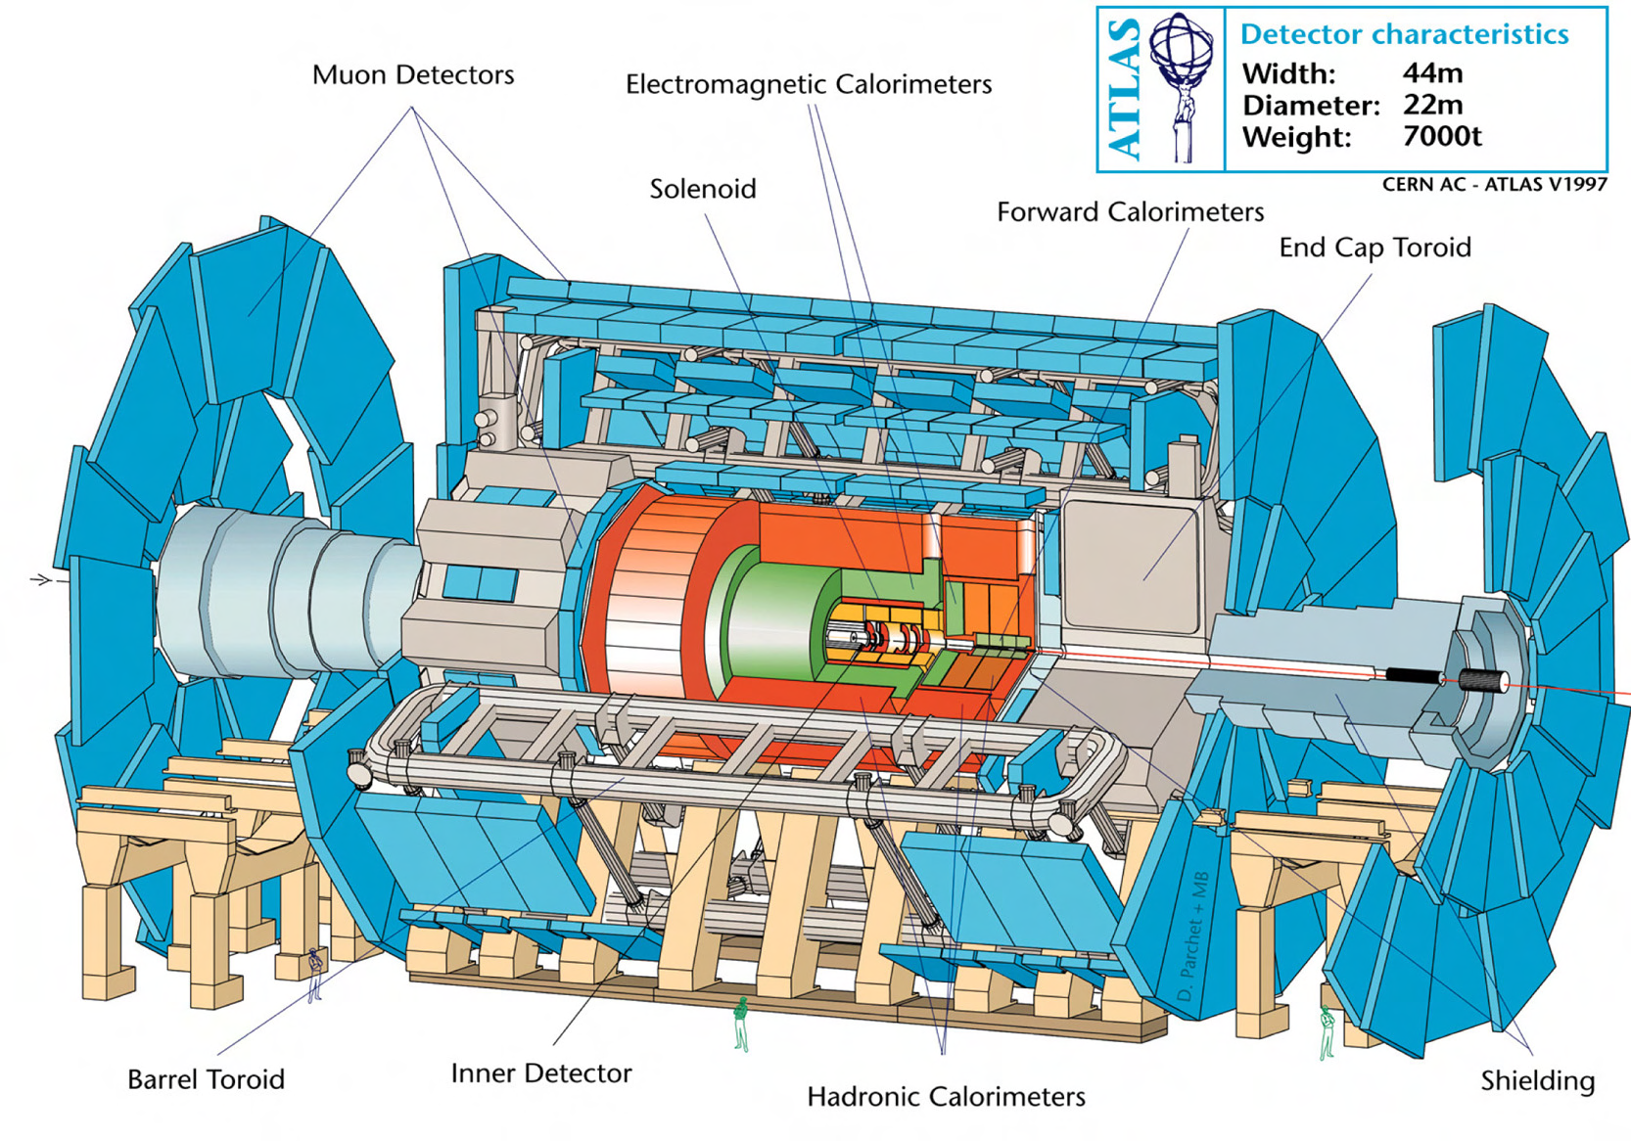
Notes:
ATLAS detector
(CERN)

Slide 11
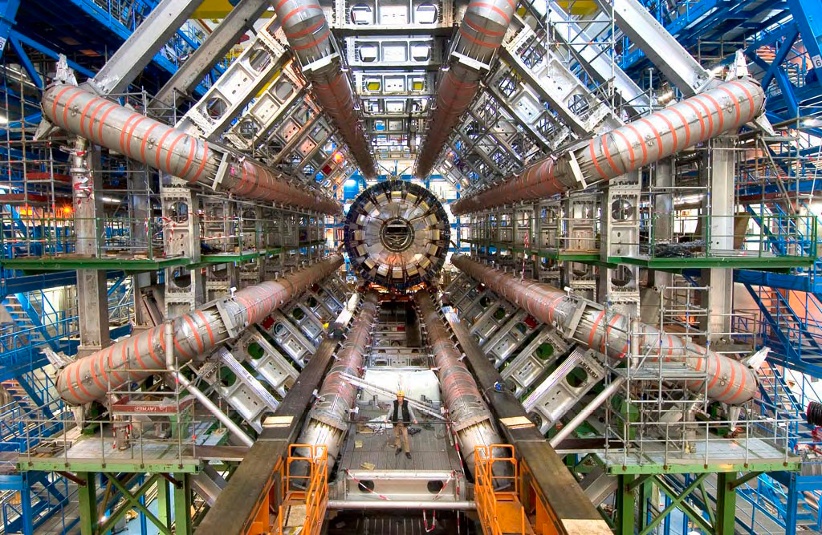
Notes:
ATLAS detector
(CERN)

Slide 12
Watch CERN video…

